Slide 1
Sustainable Silicon Valley presents:
A Regulators Workshop:
Water Conservation,
Efficiency and
Reuse in California Codes
Michael L. Nearman
Deputy Executive Director
California Building Standards Commission

Slide 2
Session Goals
Environmental policies behind CALGreen
California code development processes
Nonresidential Code updates
2016 CALGreen Code
Emergency Regulations
What’s coming in future code cycles?
Q & A

Slide 3
Environmental policies behind CALGreen
CBSC was directed to develop green building standards in response to California’s landmark initiative AB 32 (California Global Warming Solutions Act of 2006)
A comprehensive program to reduce greenhouse gas emissions (GHG) to 1990 levels by 2020

Slide 4
Environmental policies behind CALGreen
Goal: Lessen impact buildings have on the environment
2008: First CALGreen voluntary publication
(effective August 2009)
2010, 2013 & 2016: CALGreen Code publications
Increased requirements

Slide 6
California Code Development Processes
Intervening Code Cycle timeline (18 months)
Pre-cycle code development/workshops
State agency code proposals
Code Advisory Committee Reviews (6)
Public comment periods (45 and15 day)
Final submittals following Public comment period
CBSC review and approval June 2017
Codification: file with Secretary of State
Publication Jan. 2018
180 days prior to effective date July 2018

Slide 7
California Building Standards Code
Title 24, California Code of Regulations
CALGreen is Part 11 of Title 24
Includes mandatory and voluntary measures
Occupancies affected by CALGreen:
Residential
Nonresidential
Schools
Hospitals/Clinics

Slide 8
California Building Standards Code
Title 24, California Code of Regulations
Part 1 Administrative Code
Part 2 Building Code
Part 2.5 Residential Code
Part 3 Electrical Code
Part 4 Mechanical Code
Part 5 Plumbing Code
Part 6 Energy Code
Part 7 Vacant
Part 8 Historical Building Code
Part 9 Fire Code
Part 10 Existing Building Code
Part 11 Green Building Standards Code (CALGreen)
Part 12 Referenced Standards Code

Slide 9
CALGreen Code Format
Chapter 1 Administration
Chapter 2 Definitions
Chapter 3 Green Building
Chapter 4 Residential Mandatory Measures
Chapter 5 Nonresidential Mandatory Measures
Chapter 6 Referenced Organizations and Standards
Chapter 7 Installer and Special Inspector Qualifications
Chapter 8 Compliance Forms and Worksheets
Appendix A4 Voluntary Tiers (Residential)
Appendix A5 Voluntary Tiers (Nonresidential)

Slide 10
Chapter 1 - Administration
Purpose
Minimize impact of building construction on the environment
Improve construction practices
Reduce greenhouse gases and air pollution
Improve indoor air quality
Reduce use of potable water and incorporate alternative water sources
Scope
Application
Not intended to be identified as meeting the requirements of a point rated system

Slide 11
Chapter 1 - Administration
Local amendments based on findings
Climate
Topography
Geology
Alternative materials and methods
Construction documents
Application and state agency authorities

Slide 12
Chapter 3 – Green Building
Scope
301.3 Nonresidential additions and alterations. [BSC-CG]
Newly constructed buildings [N] or additions and alterations [A].
When the code section applies to both, no banner will be used.
Restrictions on plumbing fixtures in accordance with Civil Code Section 1101.3 (AB 723)

Slide 13
NONRESIDENTIAL

Slide 14
Chapter 5- Nonresidential
Mandatory Measures
Planning and Design – Division 5.1
Energy Efficiency – Division 5.2
Water Efficiency and Conservation – Division 5.3
Material Conservation and Resource Efficiency – Division 5.4
Environmental Quality – Division 5.5

Slide 15
Chapter 5- Nonresidential
Preface:
Please note the following effective dates throughout this presentation:
Right column:
2016 Triennial Code
Effective date-
Triennial: 1/1/2017
Left column:
2013 current code with intervening amendments
Effective dates-
Triennial: 1/1/2014 Intervening: 7/1/2015

Slide 16
Chapter 5- Division 5.3
Emergency regulations impacting
2013 CALGreen
Via 2013 Emergency:
Wall mounted urinals reduced to 0.125 gpf, and floor mounted urinals remain at 0.5 gpf
Outdoor potable water use regulations are now aligning with MWELO as updated in July 2015
CEC prohibition of sale or installation of non-compliant fixtures as of Jan. 2016

Slide 17
Chapter 5 - Division 5.3 Indoor Water Use
2013 Current
“Faucets and Fountains” added prescriptive only flow rates for fixtures in Section 5.303.3.4
Plumbing fixtures and fitting (standards) - CPC
2016 Code
Minor change to metering faucets for wash fountains; clarified gpc (gallons per cycle) instead of gpf (gallons per flush)
New code section: 5.303.4.1 Food Waste Disposers
Less than 1gpm when not in use
Auto shut-off after 10 min.
No more than 8 gpm in normal use
Minor editorial 2016 CPC reference updates

Slide 18
NONRESIDENTIAL VOLUNTARY MEASURES
Appendix A5
The measures contained in the appendix are not mandatory unless adopted by a city, county, or city and county. Appendix provisions may also be used voluntarily by designers, builders, and property owners.
CALGreen Tier 1 and Tier 2 are intended for adoption by cities, counties, and cities and counties to help California meet its goals for greenhouse gas emission reduction.

Slide 19
Chapter A5 - Voluntary Code
2013 Current
A5.303.3 Appliances and fixtures for commercial application
2016 Code
Increases water use efficiency
Food Steamers – no more than 2 gph
Combo Ovens – no more than
1.5 gph
New Section: A5.303.3
Food Waste Pulping Systems – no more than 2 gpm of potable water

Slide 20
Chapter A5- Voluntary Code
2013 Current
Commercial dishwasher water use Table A5.303.3
2016 Code
Updated table to meet Energy Star requirements for water use
New section: Nonwater supplied urinals (Definition for Hybrid added to Ch. 2)

Slide 21
2016 Intervening Code Cycle
Proposed Amendments
2016 Current
SWPPP (Storm Water Pollution Prevention Plan)
Shower head flow rate 2 gallons @ 80psi
2016 Code
Added new pointers to existing laws for SWPPP
New flow rate: 1.8 gallons @ 80psi to align with CEC
Title 20 standards

Slide 22
California Building Standards Commission
Use the web! www.bsc.ca.gov
Rulemaking processes
Code cycles
Current codes
Guidebooks and other resources
Information Bulletins
Commission meeting notices and agendas
Newsletters

Slide 23
California Building Standards Commission
Guide to the 2016 California Green Building Standards Code - Nonresidential
Available January 2017
Includes new Verification Guidelines

Slide 24
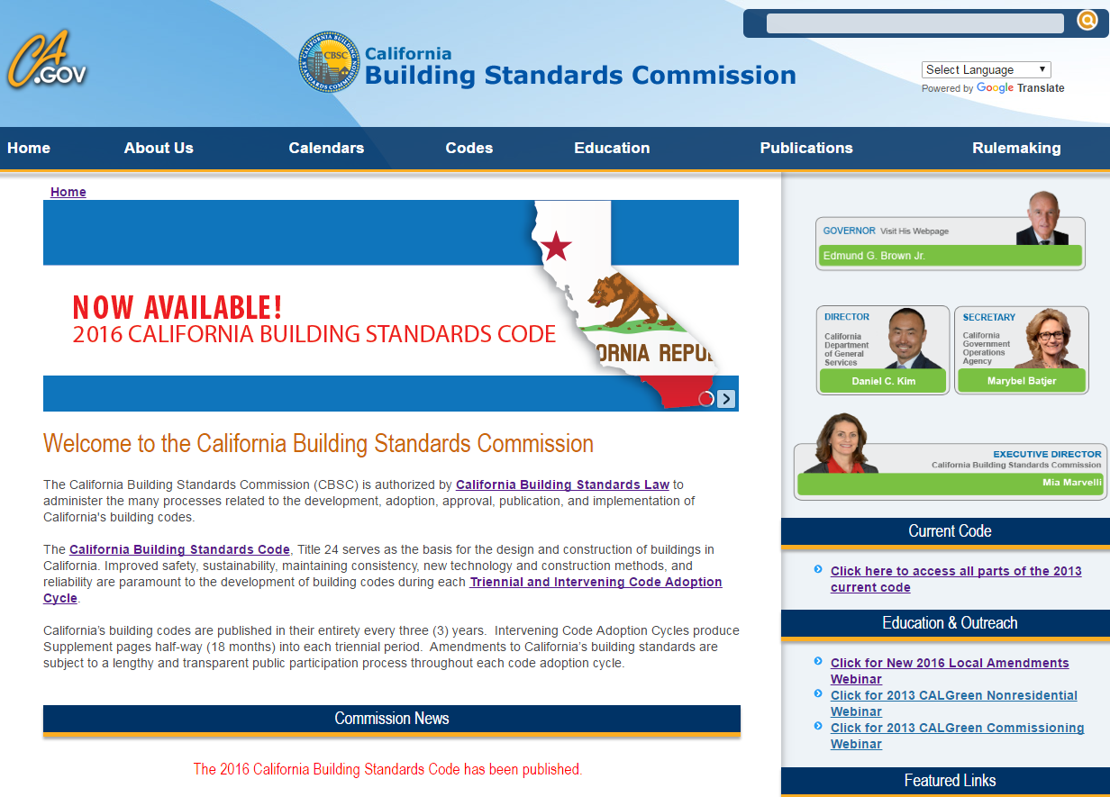

Slide 25
Additional questions about the California Codes?
Contact CBSC!
California Building Standards Commission
2525 Natomas Park Drive, Suite 130
Sacramento, CA 95833
(916) 263-0916
cbsc@dgs.ca.gov

