Slide 1
Center for Carbon Removal
Solving the other side of the climate equation
www.centerforcarbonremoval.org
@CarbonRemoval

Slide 3
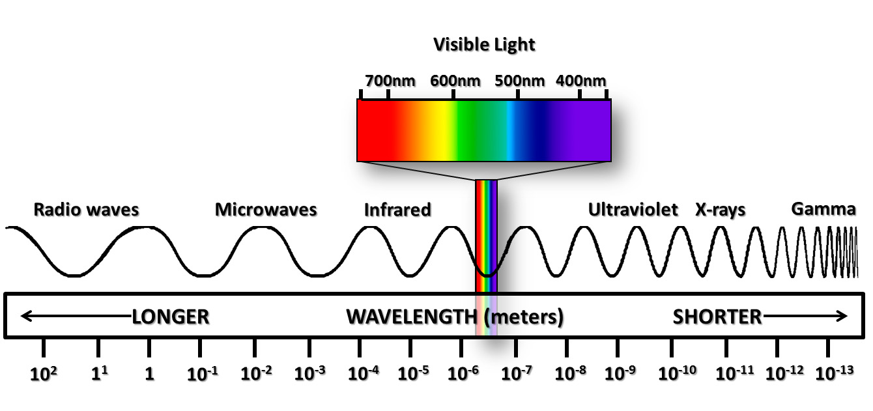
The visible portion of the electromagnetic spectrum

Slide 4
The visible portion of today’s climate mitigation spectrum
Emission Abatement:
Strategies for stopping additional CO₂ emissions
Avoided deforestation
Energy efficiency
Low-carbon energy
Climate Mitigation Portfolio

Slide 5
The full potential climate mitigation spectrum
Emission Abatement:
Strategies for stopping additional CO₂ emissions
Carbon Removal:
Strategies for cleaning up excess CO₂ from the air
Avoided deforestation
Energy efficiency
Low-carbon energy
Ecosystem restoration
Soil carbon sequestration
Negative emission energy/manufacturing
Climate Mitigation Portfolio

Slide 6
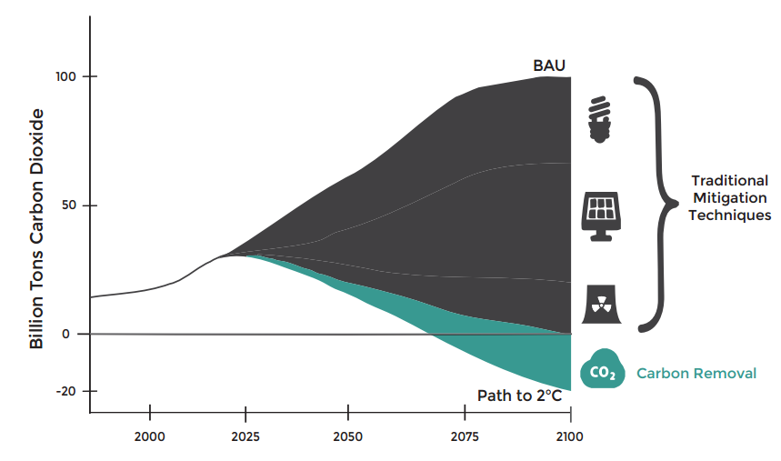
Why carbon removal?
Experts agree: virtually every viable way to meet our ambitious climate goals relies on carbon removal.

Slide 7
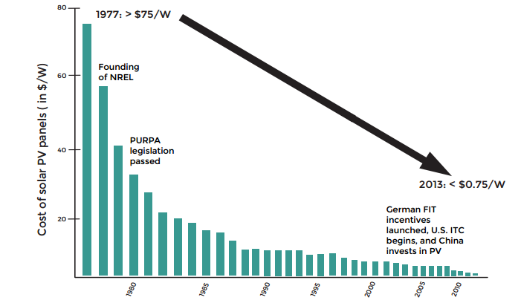
Now is the time to start tackling the tough questions on carbon removal solutions
The solar “miracle” required decades of advocacy to get support for R&D and steady deployment incentives + industry action

