Slide 1
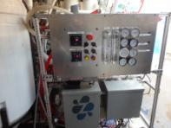
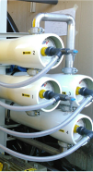
Water Efficient Technology (WET) Rebates Supporting Solutions for a Water Sustainable Future
Neeta Bijoor, PhD
December 5, 2017

Slide 2
Water demands in Santa Clara County
2
2
Notes:
Business water use accounts for a significant portion of water use in our county. Though residential use makes up just over half of all water used in the county, business makes up about one-third of water usage. Ag is only 8% of all water used in the county. There’s also a tiny sliver for what’s called dedicated meter landscaping—it’s literally landscaping that has its own metered usage.

Slide 3
Your Water District is Here to Help!
Notes:
We are here to help you Make Conservation a Way of Life. A variety of programs and resources are available, many of them are free. You can learn more online. I’m going to focus on our commercial rebates.

Slide 4
Your Water District is Here to Help!
Notes:
We are here to help you Make Conservation a Way of Life. A variety of programs and resources are available, many of them are free. You can learn more online. I’m going to focus on our commercial rebates.

Slide 5
Water Efficient Technology (WET) Rebate
Your business can receive up to $50,000 for the installation of water efficient technology!
Provided by Santa Clara Valley Water District
Commercial, Institutional, and Industrial customers
Subject to funding availability
Requirements must be met

Slide 6
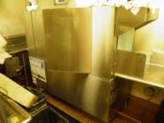
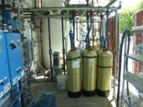
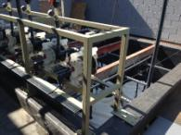
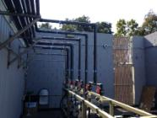
Flexible and Customized Approach
A wide range of technology qualifies for a rebate

Slide 7
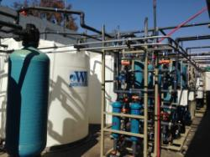
Additional Benefits of WET Rebates
Modernize your facility
Save money on your water bill
Conserve water

Slide 8
Rebate Amount
$4 per CCF* up to 50% of project cost
Maximum rebate: $50,000
Minimum rebate: $400
*1 CCF = 748 gallons
$

Slide 9
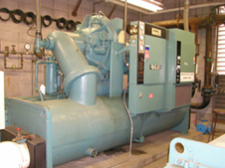
Sample Projects
Onsite water reuse
Treated wastewater used again at the facility
Untreated process water used for a different purpose
Cooling tower efficiency upgrades
Chiller efficiency upgrades (e.g. air cooled)
Ozone systems for laundry
Note: The Santa Clara Valley Water District does not endorse or promote any specific company or their products.

Slide 10
Onsite Reuse Rebate Examples
Local Printed Circuit Boards Manufacturer
Rebate: $15,220
40% of project cost
2,846,140 gallons saved annually (3,805 CCF)
Local Electronics Company
Rebate: $47,988
43% of project cost
8,973,756 gallons saved annually (11,997 CCF)
Notes:
Hadco in ‘99. Had to use an old one to find high percentage of project cost coverage with high rebate

Slide 11
Neeta Bijoor, PhD nbijoor@valleywater.org 408-630-2040
http://www.valleywater.org/Programs/CommercialRebates.aspx
Notes:
With that, I’ll thank you for your time today and answer any questions you may have.

