Slide 1
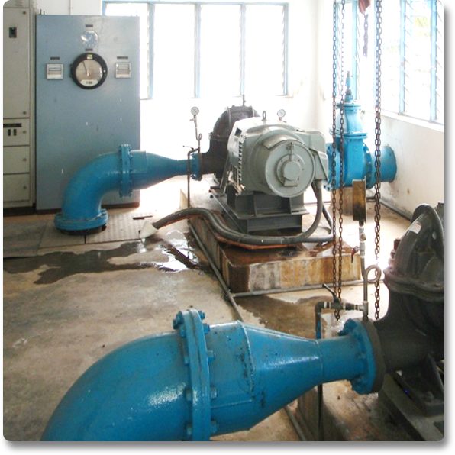
Traditional Water Booster System
One duty pump operating to supply the maximum demand with constant pressure by means of control or pressure reducing valves and/or variable frequency drive (VFD).
Many systems are constant speed!
Additionally one identical pump and VFD as standby
Energy is wasted, and undue pressure put on piping systems
Notes:
A traditional installation tackles the challenges at a pumping station by relying on one duty pump supplying the demand.
Constant pressure is maintained by means of valves or a variable frequency drive.
One identical pump and drive are also installed as standby in case of breakdown.

Slide 2
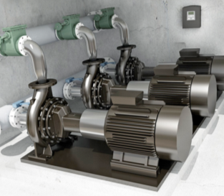
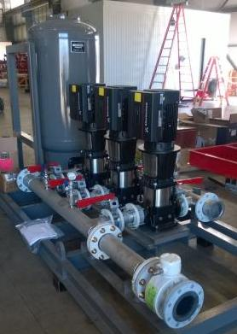
The Grundfos Way: Demand Driven Distribution
Design the system to supply exactly the flow you need at the pressure you need
More smaller pumps running at best efficiency point, instead of 1 big pump
Smaller footprint
Save Money! Reduce energy costs by 25-40%
Save Water! Reduce leakages and pressure surges in network pipes by 15-25%
Intelligent control system with optional remote management
Reduce water hammer
Open communication standards to SCADA or other systems
Notes:
A proportional pressure solution from Grundfos also meets these challenges, and with the following benefits:
Design the system to supply exactly the flow you need at the pressure you need
More small pumps running at best efficiency point, instead of one big pump
Reduce energy cost by 25%
Reduce leakages and pressure surges in network pipes by 15%
Reduce water hammer
Controls can be integrated to SCADA systems through a number of fieldbus protocols
2

