Slide 1
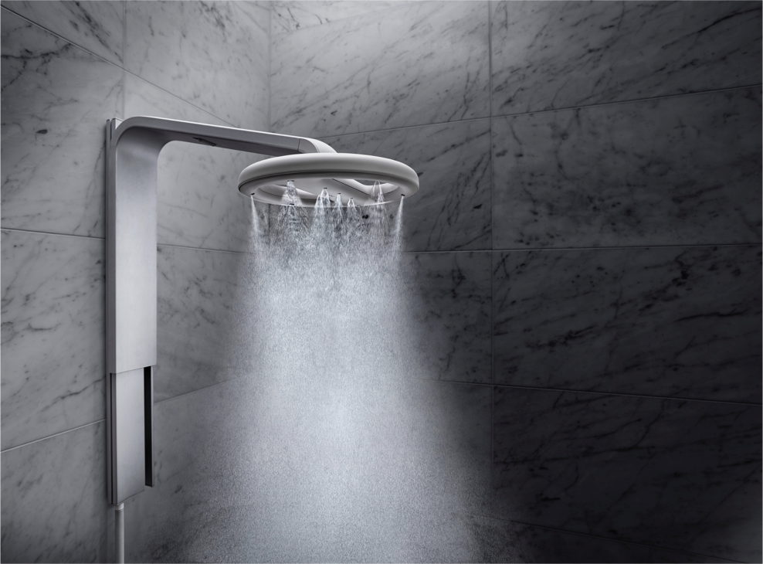

Slide 2
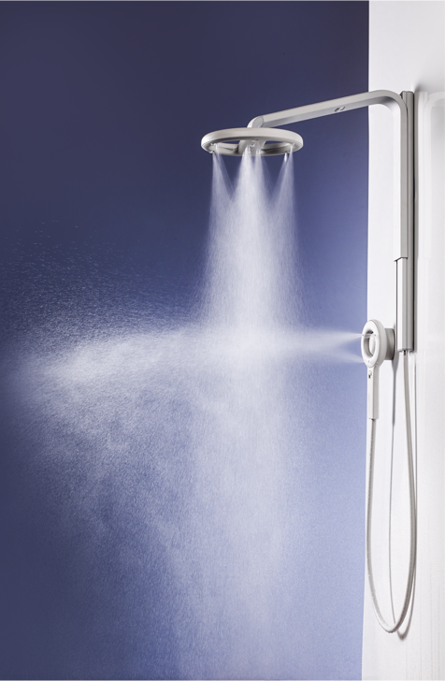
Company Information
70%
Water savings compared to industry average
5,200
Gallons of water saved per person/year
13,000
Units installed around the world
Local Institutional Customers

