Slide 1
SUEZ’s industrial water activities
GE
Water & Process Technologies
Water Technologies & Solutions
Water Technologies
& Solutions
SUEZ
90,000+ employees
450,000 business and industrial customers worldwide
€120m combined annual R&D investment
employees
Resource Revolution
10,000
Water Reuse (UF/MBR/RO/UV/O3)
IPR/DPR
Title 22 NPR
Irrigation
Energy Neutral WWTP
Energy Recovery (ADT)
Intensified Nitrification (MABR)
Nutrient Recovery
Biosolids and Biowaste
Zero-liquid-discharge
Recycling Plastic/Glass/Metals
industrial and municipal
customers addressed
worldwide
50,000+
10,000+
combined technologies
11,4m
m³ of water treated per day
Notes:
SUEZ Industrial water activities and GE W&PT are integrated into a new Business Unit dedicated to Water Technologies and Solutions.
This new BU, with a global footprint, brings expertise and innovation in water and process solutions help our customer’s improve economic and environmental performance.

Slide 2
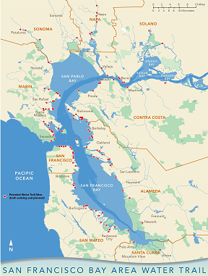
Geysers Water Reuse Reinjection 20 MGD
Bay Area
Sustainability
Champions
Cache Creek MBR/EDR AWWTP *
Santa Rosa WRF 12.6 MGD
Carnaros Inn WRF *
NRG Pittsburg PP UF BWDPRO *
American Canyon MBR UV WWTP 3.7 MGD *
Ironhouse SD MBR/UV WRF 4.3 MGD *
Drops & Energy
Being Spared
in Bay Area
2017
EBMUD Chevron NRWRF 4.0 MGD
Delta Diablo WRF 12 MGD
LGVSD WRF 1.4 MGD (5.4 MGD Exp.) *
EBMUD Chevron RARE WRF 3.5 MGD
Calpine Delta Energy Center
EBMUD ALAMEDA WRF 2.3 MGD
Calpine Los Medanos Energy Center
EBMUD ADT & SSOW 55 MW
SFPUC Westside ARWP 2 MGD
DSRSD RWTF 1.2 MGD ADRWF (2016)
Daly City/SFPUC NSMCSD Tertiary RWP 2.8 MGD (3 MGD Exp.)
Calpine Russell City Energy Center 1.5 MGD Reuse & ZLD *
MABR Lower Energy Intensified Nitrification *
San Mateo CWP BNR/MBR AWWTP Upgrade 21 MGD
South Bay Water Recycling - City of San Jose + SCVWD 20 MGD
SVCW SAF-MBR Demo WWTP *
SJ/SC WPCP
+
SVAWPC MF RO UV 8 MGD
ReNUWIt Stanford Codiga RRC SAF-MBR Demo *
Calpine Metcalf Energy Center 2.5 MGD
(Note: “*” denotes Suez technology applied)
Palo Alto RWQCP 3.0 MGD
SCRWA 8 MGD (2.5 MGD Exp.)
Sunnyvale WPCP 11.9 MGD (1.3 MGD Reuse)
Hollister MBR WRF 2.1 MGD (4 MGD Exp.) *

